Slide 2
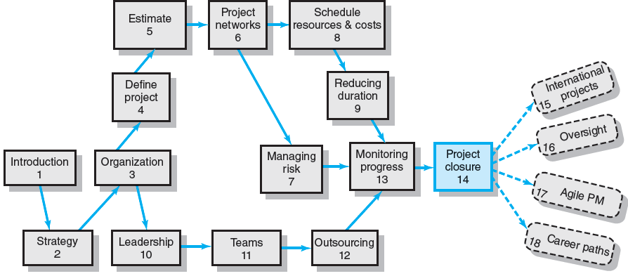
Where We Are Now

Slide 3
Those who cannot remember the past are condemned to relive it
Carefully managing the closure phase is as important as any other phase of the project.
Observation tells us that organizations that manage closure and review well prosper.
Those who don’t tend to have projects that drag on forever and repeat the same mistakes over and over.

Slide 4
Project Closure
In today’s project-driven organizations that have many projects occurring simultaneously, the responsibility for completing closure tasks has been parsed among the project manager, project teams, project office, an oversight “review committee,” and an independent retrospective facilitator.
Many tasks overlap, occur simultaneously, and require coordination and cooperation among these stakeholders.

Slide 5
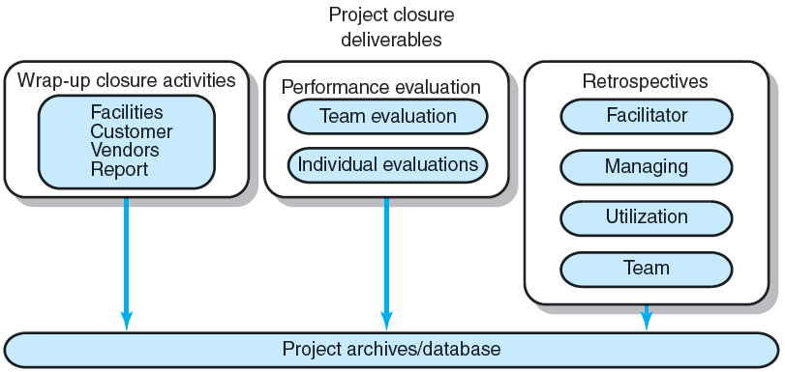
Project Closure and Review Deliverables
FIGURE 14.1

Slide 6
Wrapping up the project
The major wrap-up task is to ensure the project is approved and accepted by the customer.
Other wrap-up activities include closing accounts, paying bills, reassigning equipment and personnel, finding new opportunities for project staff, closing facilities, and the final report.

Slide 7
Evaluation of performance and management of the project
Evaluation includes team, individual team members, and project manager performance.
Vendors and the customer may provide external input.
Evaluation of the major players provides important information for the future.

Slide 8
Retrospectives
Retrospectives of lessons learned are designed to improve performance on current and future projects.
Today, most retrospectives are the responsibility of an independent facilitator.
The facilitator also provides major input to the closure report that will include lessons learned.
These post-project reviews should be held with the team to catch any missing issues or gaps.

Slide 9
Types of Project Closure
Normal
a completed project
Premature
be completed early with some parts of the project eliminated
Perpetual
Some projects never seem to end
Failed Project
Changed Priority
Organizations’ priorities often change and strategy shifts directions

Slide 10
Project Closure
Close-out Plan: Questions to be Asked
What tasks are required to close the project?
Who will be responsible for these tasks?
When will closure begin and end?
How will the project be delivered?

Slide 11
Closure process
1. Getting delivery acceptance from the customer.
2. Shutting down resources and releasing to new uses.
3. Reassigning project team members.
4. Closing accounts and seeing all bills are paid.
5. Delivering the project to the customer.
6. Creating a final report.

Slide 12
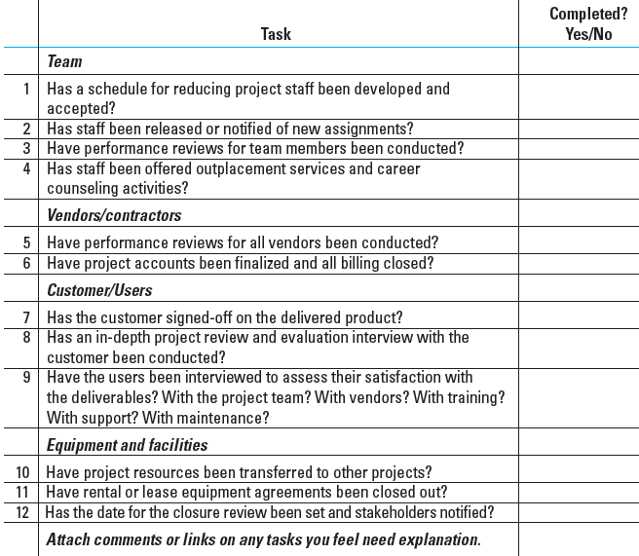
Wrap-up Closure Checklist
TABLE 14.1

Slide 13
Implementing Project Closedown
Getting delivery acceptance from the customer.
Shutting down resources and releasing them to new uses.
Evaluating the team, team members and the project manager; and reassigning project team members.
Closing accounts and paying all bills.
Delivering the project to the customer.
Creating a final report.

Slide 14
Creating the Final Report
Executive Summary
Project goals met/unmet
Stakeholder satisfaction with project
User reactions to quality of deliverables
Review and Analysis
Project mission and objective
Procedures and systems used
Organization resources used
Recommendations
Technical improvements
Corrective actions
Lessons Learned
Reminders
Retrospectives
Appendix
Backup data
Critical information

Slide 15
Project Performance Evaluations
Reasons for Poor-Quality Project Performance Evaluations:
Evaluations of individuals are left to supervisors of the team member’s home department.
Typically measure team performance only on time, cost, and specifications.

Slide 16
Pre-Implementation Conditions: Team
Are standards and goals for measuring performance clear, challenging, and attainable? Lead to positive consequences?
Are responsibilities and performance standards known by all team members?
Are team rewards adequate? Management believes teams are important?
Is there a career path for successful project managers
Does the team have discretionary authority to manage short-term difficulties?
Is there a high level of trust within the organization culture?
Are there criteria beyond time, cost, and specifications?

Slide 17
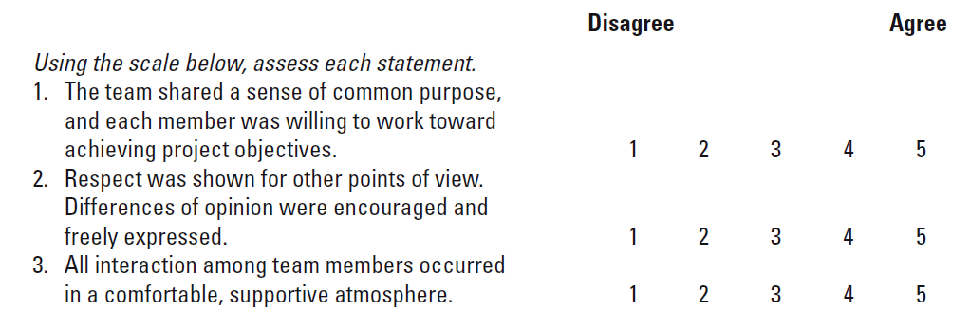
Sample Team Evaluation and Feedback Survey
TABLE 14.2

Slide 18
Project Performance Evaluation: Individual
Performance Assessment Responsibilities:
Functional organization or functional matrix: the individual’s area manager.
The area manager may solicit the project manager’s opinion of the individual’s performance on a specific project.
Balanced matrix: the project manager and the area manager jointly evaluate an individual’s performance.
Project matrix and project organizations: the project manager is responsible for appraising individual performance.

Slide 19
Conducting Performance Reviews
Begin by asking the individual to evaluate his or her own performance.
Avoid drawing comparisons with other team members; rather, assess the individual in terms of established standards and expectations.
Focus criticism on specific behaviors rather than on the individual personally.
Be consistent and fair in treatment of all team members.
Treat the review as one point in an ongoing process.

Slide 20
Individual Performance Assessment
Multiple rater appraisal (“360-degree feedback)
Involves soliciting feedback concerning team members’ performance from all of the people that their work affects.
Project managers, area managers, peers, subordinates, and customers.

Slide 21
Retrospectives
Lessons Learned
An analysis carried out during and shortly after the project life cycle to capture positive and negative project learning—“what worked and what didn’t?”
Goals of Retrospectives
To reuse learned solutions
To stop repetitive mistakes

Slide 22
Retrospectives (cont’d)
Barriers to Organizational Learning
Lack of post-project time for developing lessons
No post-project direction or support for teams
Lessons become blame sessions
Lessons are not applied in other locations
Organizational culture does not recognize value of learning

Slide 23
The Value of Retrospective Analyses
Making Retrospectives Effective:
Use an independent facilitator to guide the project team through the analysis project activities.
Include a minimum of three in-process learning gates during the life project cycle.
Designate a team member as owner for each point in the retrospective.
Develop an easy-to-use learning repository to ensure future utilization of retrospective lessons.
Mandate use of retrospectives as part of the normal process for all projects.

Slide 24
Characteristics of a Closure Facilitator
No direct involvement or direct interest in the project.
Perceived as impartial and fair
Respect of senior management and other project stakeholders.
Willingness to listen.
Independence and authority to report audit results without fear of recriminations from special interests.
Perceived as having the best interests of the organization in making decisions.
Broad-based experience in the organization or industry.

Slide 25
Initiating the Retrospective Review
Have automatic times or points when audits will take place. Avoid surprises.
Conduct audits carefully and with sensitivity.
Audit staff must independent from the project.
Audit reports need to be used and accessible.
Audits support organizational culture.
Project closures should be planned and orderly.
Certain “core conditions” must be in place to support team and individual evaluation.
Conduct individual and team evaluations separate from pay or merit reviews.

Slide 26
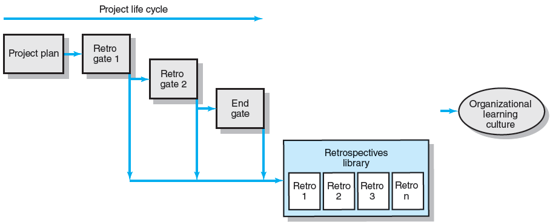
The Retrospectives Process
FIGURE 14.2

Slide 27
Conducting a Retrospective Analysis
Initiation and staffing
Data collection and analysis
Reporting

Slide 28
Project Process Review Questionnaire
Were the project objectives and strategic intent of the project clearly and explicitly communicated?
Were the objectives and strategy in alignment?
Were the stakeholders identified and included in the planning?
Were project resources adequate for this project?
Were people with the right skill sets assigned to this project?
Were time estimates reasonable and achievable?
Were the risks for the project appropriately identified and assessed before the project started?
Were the processes and practices appropriate for this type of project? Should projects of similar size and type use these systems? Why/why not?
Did outside contractors perform as expected? Explain.
Were communication methods appropriate and adequate among all stakeholders? Explain.
Is the customer satisfied with the project product?
Are the customers using the project deliverables as intended? Are they satisfied?
Were the project objectives met?
Are the stakeholders satisfied their strategic intents have been met?
Has the customer or sponsor accepted a formal statement that the terms of the project charter and scope have been met?
Were schedule, budget, and scope standards met?
Is there any one important area that needs to be reviewed and improved upon? Can you identify the cause?
TABLE 14.3

Slide 29
Organizational Culture Review Questionnaire
Was the organizational culture supportive for this type of project?
Was senior management support adequate?
Were people with the right skills assigned to this project?
Did the project office help or hinder management of the project? Explain.
Did the team have access to organizational resources (people, funds, equipment)?
Was training for this project adequate? Explain.
Were lessons learned from earlier projects useful? Why? Where?
Did the project have a clear link to organizational objectives? Explain.
Was project staff properly reassigned?
Was the Human Resources Office helpful in finding new assignments? Comment.
TABLE 14.4

Slide 30
Archiving Retrospectives
Classifying of Projects:
Project type
Size
Staffing
Technology level
Strategic or support
Issues and problems
Project mission and objectives
Procedures and systems used
Organization resources used

Slide 31
Key Terms
Lessons learned
Performance review
Project closure
Project evaluation
Project facilitator
Retrospective
Team evaluation
360-degree review

Slide 32
Project Closeout Checklist

Slide 33
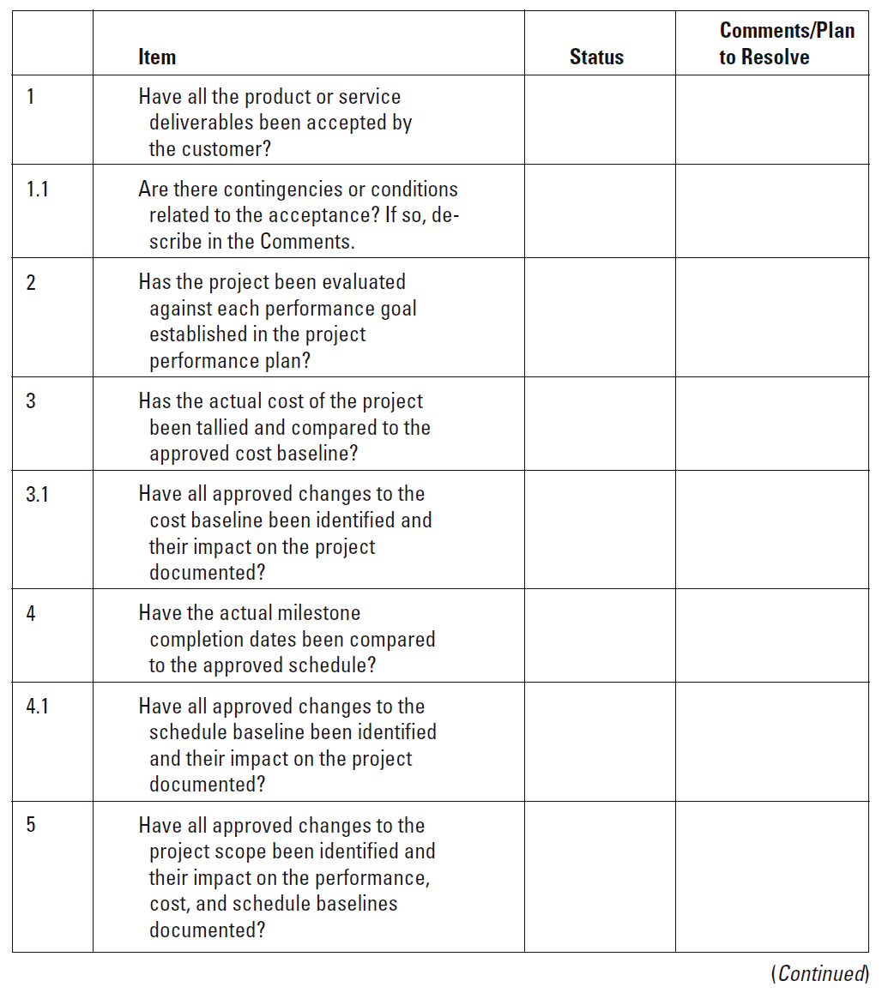
Project Closeout Checklist

Slide 34
Euro Conversion—Project Closure Checklist

Slide 35
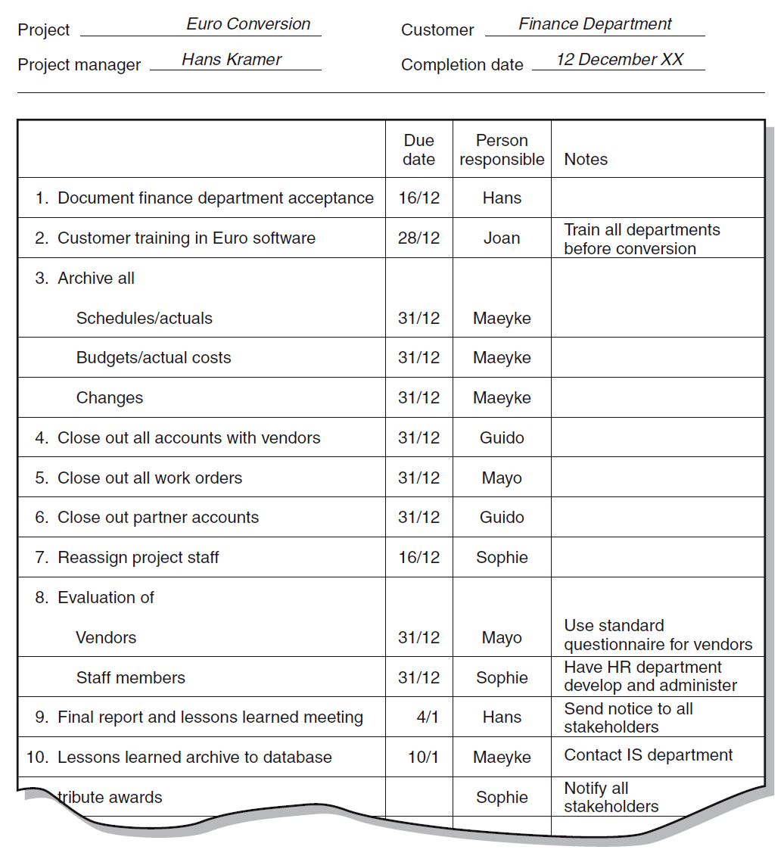
Euro Conversion—Project Closure Checklist

